Slide 1
ANALYSIS OF REVIEWS OF BRITISH AIRWAYS
BY: ASHINZE EMMANUEL

Slide 2
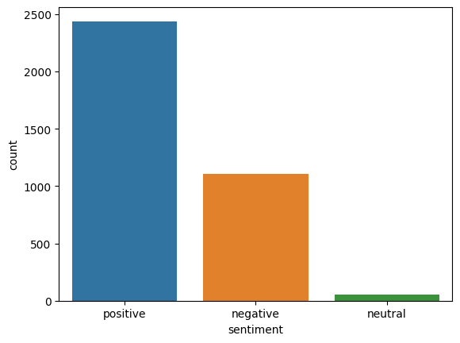
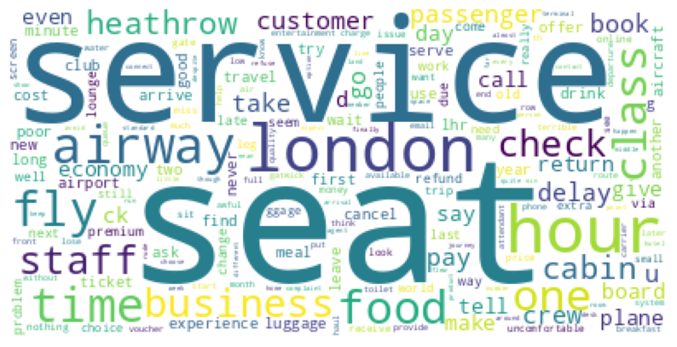
SUMMARY OF FINDINGS
68% of the reviews are positive
Flight is the most common word in the reviews
Common Words in Negative Reviews

